Slide 1
Autonomous Cars
And their ethical considerations

Slide 2
What could go wrong?
Unlikely to have ‘trolley problem’ situation, where the car has to choose to swerve or not
When have you ever had to swerve wildly
Just brake
More likely to not recognise an object in front of it or get distances wrong
Could also be unable to judge driving conditions and go too fast
Random software glitches could also happen

Slide 3
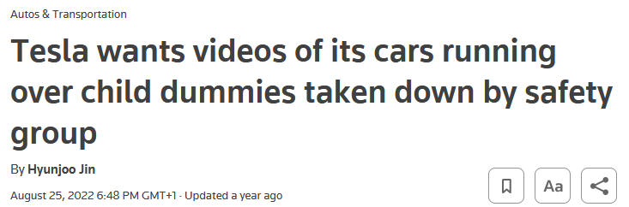
Teslas can’t see children
https://www.reuters.com/business/autos-transportation/tesla-wants-videos-its-cars-running-over-child-dummies-taken-down-by-safety-2022-08-25/

Slide 4
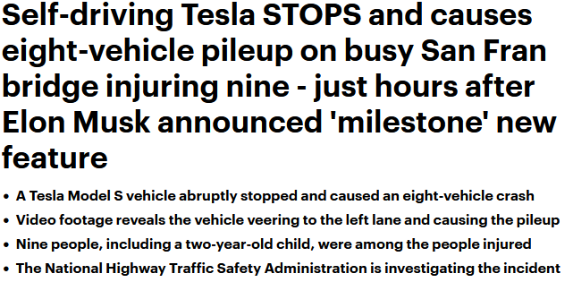
I don’t like teslas
https://www.dailymail.co.uk/news/article-11620595/Moment-self-driving-Tesla-abruptly-stops-causes-EIGHT-vehicle-pileup.html

Slide 5
So who’s liable if it does go wrong?

Slide 6
Who knows
Assuming the user hadn’t messed with any systems, it’s probably the company
But that’s also kinda meaningless, does it mean shareholders (unlikely), management, manufacturing, designers, testers/QA
Money wise, insurance would take the hit, but I doubt they would be happy to pay out
https://news.sky.com/story/self-driving-cars-motorists-will-not-be-liable-for-crashes-and-can-watch-tv-behind-the-wheel-government-says-12593826
https://www.qmul.ac.uk/lac/our-legal-blog/items/reliability-of-autonomous-cars.html

Slide 7
Management
Has signoff
Controls process
Doesn’t need to know anything

Slide 8
Manufacturing
No influence on car’s behaviour

Slide 9
designers
Actually create the systems governing the car’s behaviour

Slide 10
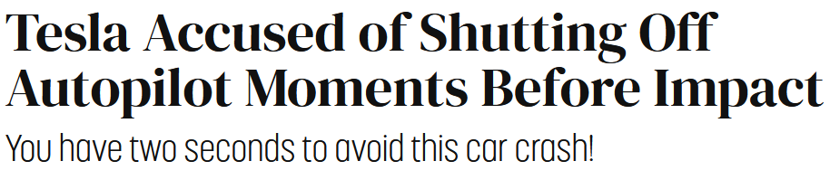
But the company has better lawyers than you do
Admittedly it was only 16 cases out of over 200 were self driving features were involved
https://futurism.com/tesla-nhtsa-autopilot-report

Slide 11
Just take a bus
It’s less of a legal headache

